Slide 1

FPT University
Android programMing
Lesson 22
Version 1.0

Slide 2
Agenda
Overview of Fingerprint Authentication
Configuring Device Fingerprint Authentication
Fingerprint Authentication Project

Slide 3
Overview of Fingerprint Authentication
Fingerprint authentication uses the touch sensor built into many Android devices to identify the user and provide access to both the device and application functionality such as in-app payment options.

Slide 4
Overview of Fingerprint Authentication
There are essentially 10 steps to implementing fingerprint authentication within an Android app. These steps can be summarized as follows:
Request fingerprint authentication permission within the project Manifest file.
Verify that the lock screen of the device on which the app is running is protected by a PIN, pattern or password
Verify that at least one fingerprint has been registered on the device.
Create an instance of the FingerprintManager class.

Slide 5
Overview of Fingerprint Authentication
Use a Keystore instance to gain access to the Android Keystore container. This is a storage area used for the secure storage of cryptographic keys on Android devices.
Generate an encryption key using the KeyGenerator class and store it in the Keystore container.
Initialize an instance of the Cipher class using the key generated in step 5.
Use the Cipher instance to create a CryptoObject and assign it to the FingerprintManager instance created in step 4.
Call the authenticate method of the FingerprintManager instance.
Implement methods to handle the callbacks triggered by the authentication process.

Slide 6
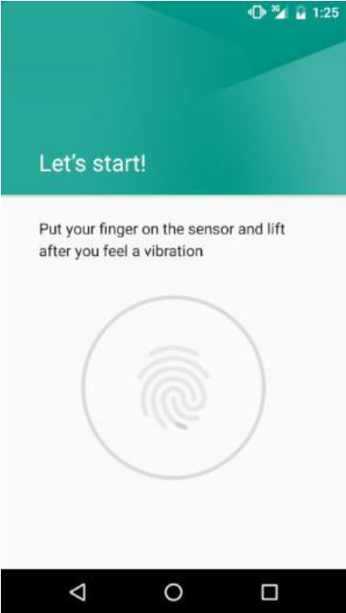
Configuring Device Fingerprint Authentication
Fingerprint authentication is only available on devices containing a touch sensor.

Slide 7
Fingerprint Authentication Project Example
Adding the Fingerprint Permission to the Manifest File
<uses-permission android:name="android.permission.USE_FINGERPRINT"/>

Slide 8


Fingerprint Authentication Project Example
Adding the Fingerprint Icon

Slide 9
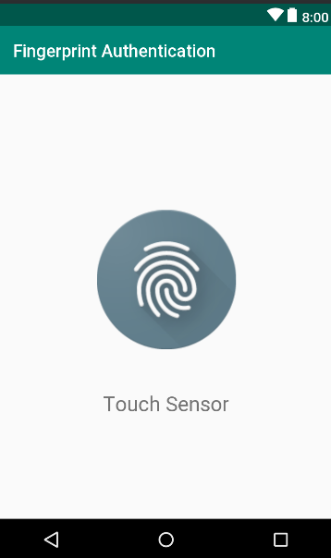
Fingerprint Authentication Project Example
Designing the User Interface

Slide 10
Fingerprint Authentication Project Example
Accessing the Keyguard and Fingerprint Manager Services
private FingerprintManager fingerprintManager; private KeyguardManager keyguardManager; @Override protected void onCreate(Bundle savedInstanceState) { super.onCreate(savedInstanceState); setContentView(R.layout.activity_fingerprint_authentication); keyguardManager = (KeyguardManager) getSystemService(KEYGUARD_SERVICE); fingerprintManager = (FingerprintManager) getSystemService(FINGERPRINT_SERVICE);
}

Slide 11
Fingerprint Authentication Project Example
Checking the Security Settings
if (!keyguardManager.isKeyguardSecure()) { Toast.makeText(this, "Lock screen security not enabled in Settings", Toast.LENGTH_LONG).show(); return; } if (ActivityCompat.checkSelfPermission(this, Manifest.permission.USE_FINGERPRINT) != PackageManager.PERMISSION_GRANTED) { Toast.makeText(this, "Fingerprint authentication permission not enabled", Toast.LENGTH_LONG).show(); return; } if (!fingerprintManager.hasEnrolledFingerprints()) { // This happens when no fingerprints are registered. Toast.makeText(this, "Register at least one fingerprint in Settings", Toast.LENGTH_LONG).show(); return; }

Slide 12
Fingerprint Authentication Project Example
Accessing the Android Keystore and KeyGenerator
private KeyStore keyStore; private KeyGenerator keyGenerator; protected void generateKey() { try { keyStore = KeyStore.getInstance("AndroidKeyStore"); keyGenerator = KeyGenerator.getInstance(KeyProperties.KEY_ALGORITHM_AES, "AndroidKeyStore"); keyStore.load(null); keyGenerator.init(new KeyGenParameterSpec.Builder(KEY_NAME, KeyProperties.PURPOSE_ENCRYPT | KeyProperties.PURPOSE_DECRYPT) .setBlockModes(KeyProperties.BLOCK_MODE_CBC) .setUserAuthenticationRequired(true) .setEncryptionPaddings( KeyProperties.ENCRYPTION_PADDING_PKCS7) .build()); keyGenerator.generateKey(); } catch (Exception e) { e.printStackTrace(); } }

Slide 13
Fingerprint Authentication Project Example
Initializing the Cipher
private Cipher cipher; public boolean cipherInit() { try { cipher = Cipher.getInstance( KeyProperties.KEY_ALGORITHM_AES + "/" + KeyProperties.BLOCK_MODE_CBC + "/" + KeyProperties.ENCRYPTION_PADDING_PKCS7); keyStore.load(null); SecretKey key = (SecretKey) keyStore.getKey(KEY_NAME, null); cipher.init(Cipher.ENCRYPT_MODE, key); return true; } catch (Exception e) { e.printStackTrace(); return false; } }
Notes:
the cipher that will be used to create the encrypted FingerprintManager.CryptoObject instance

Slide 14
Fingerprint Authentication Project Example
Creating the CryptoObject Instance
generateKey(); if (cipherInit()) { cryptoObject = new FingerprintManager.CryptoObject(cipher); }

Slide 15
Fingerprint Authentication Project Example
Implementing the Fingerprint Authentication Handler Class
public class FingerprintHandler extends FingerprintManager.AuthenticationCallback{
private CancellationSignal cancellationSignal; private Context appContext;
public FingerprintHandler(Context context) { appContext = context; } }

Slide 16
Fingerprint Authentication Project Example
Implement start authenticate method
public void startAuth(FingerprintManager manager, FingerprintManager.CryptoObject cryptoObject) { cancellationSignal = new CancellationSignal(); if (ActivityCompat.checkSelfPermission(appContext, Manifest.permission.USE_FINGERPRINT) != PackageManager.PERMISSION_GRANTED) { return; } manager.authenticate(cryptoObject, cancellationSignal, 0, this, null); }

Slide 17
Fingerprint Authentication Project Example
Handler other override methods
@Override public void onAuthenticationError(int errMsgId, CharSequence errString) { Toast.makeText(appContext, "Authentication error\n" + errString, Toast.LENGTH_LONG).show(); } @Override public void onAuthenticationHelp(int helpMsgId, CharSequence helpString) { Toast.makeText(appContext, "Authentication help\n" + helpString, Toast.LENGTH_LONG).show(); }

Slide 18
Fingerprint Authentication Project Example
@Override public void onAuthenticationFailed() { Toast.makeText(appContext, "Authentication failed.", Toast.LENGTH_LONG).show(); } @Override public void onAuthenticationSucceeded( FingerprintManager.AuthenticationResult result) { Toast.makeText(appContext, "Authentication succeeded.", Toast.LENGTH_LONG).show(); }

Slide 19
Fingerprint Authentication Project Example
Final step, start the authentication
FingerprintHandler helper = new FingerprintHandler(this); helper.startAuth(fingerprintManager, cryptoObject);

Slide 20
Fingerprint Authentication Project Example
Testing the Project

Slide 21

End of Lesson 22

Slide 22
Thank you!

